Slide 1








Document Classification
Using Image & Text Features:
A Multi-Modal AI Approach
Under the Guidance of:
Dr. Chaojie Wang
DATA 606 – Capstone in Data Science
Submitted by:
Ujjwal (PF10610)
University of Maryland, Baltimore County

Slide 2

About Me
Ujjwal
Student, MPS Data Science
UMBC Global Ambassador
Graduate Grader, Data Science Department
University of Maryland, Baltimore County
Skills:
Python, SQL, MATLAB
Tableau, Microsoft Azure, Microsoft Office
Statistical Analysis, Data Visualization, Time-Series Analysis, Machine Learning, Deep Learning, Natural Language Processing
Projects:
California Drought Analysis & Prediction
Twitter Sentiment Analysis & Stock Prices Prediction
Rotor-Bar Fault Detection in 3 Phase Induction Motor

Slide 3
What is Document Classification?
1
Document
Item of information that has content related to some specific category.
Document Classification
2
Process of assigning categories
To documents to make them easier to manage, search, filter, or analyze.
3
Collaborative task
Dealing with text classification and visual classification

Slide 4



Why is Document Classification Important?
Crucial for Organizations
Effective
Fast and efficient
Helps in saving information
And
Finding documents whenever required
For collection and storage of data
And frees up human resources for better brainstorming works in any organization

Slide 5
About the Dataset
1
DATASET SOURCE:
Kaggle (link: https://www.kaggle.com/patrickaudriaz/tobacco3482jpg)
2
DATA SIZE:
2 GB
3
NUMBER OF ENTITIES:
3492 Documents
4
TYPES OF DOCUMENTS:
Advertisement, Email, Form, Letter, Memo, News, Note, Report, Resume, Scientific
5
RESEARCH PAPER:
Jayant Kumar, Peng Ye and David Doermann. "Learning Document Structure for Retrieval and Classification." International Conference on Pattern Recognition (ICPR 2012), 2012

Slide 6
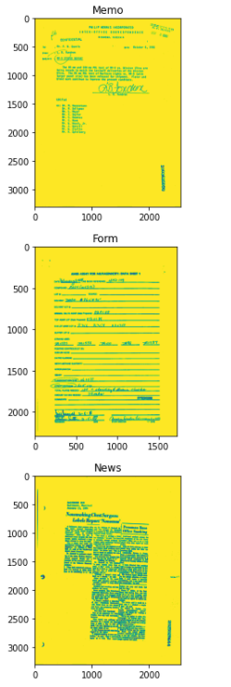
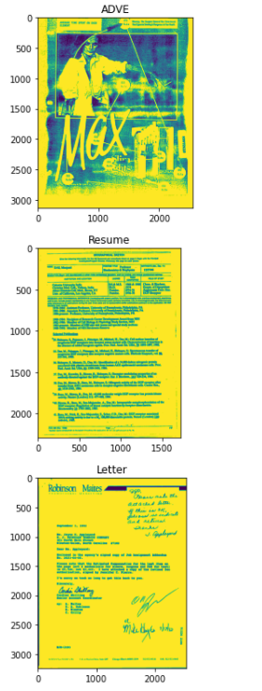
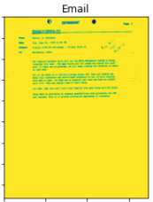
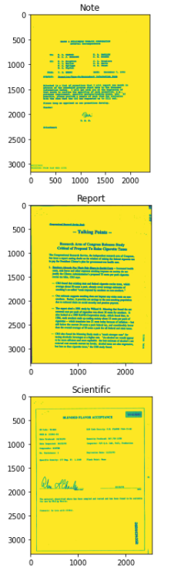
Sample Images From Dataset

Slide 7
Research Questions
Comparison
Manual Document Classification Vs Automated Document Classification
Impact
How automated document classification can impact an organization
Effectiveness
Of Multi-Modal approach

Slide 8





Methodology
05
04
03
02
01
Dataset Preparation
Text Preprocessing & Feature Engineering
Model Evaluations
Multi-Modal prediction
Model Tuning
Retrieving text from images using Optical Character Recognition (OCR) libraries
Using image features and textual features individually for model training and comparing the results
Combining image features and textual features for prediction
Observing effects of varying parameters
Text cleaning, tokenization, stemming, lemmatization, word clouds

Slide 9

Exploratory
Data
Analysis

Slide 10
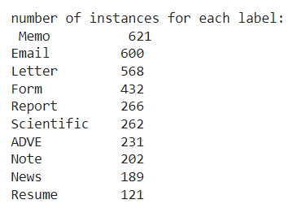
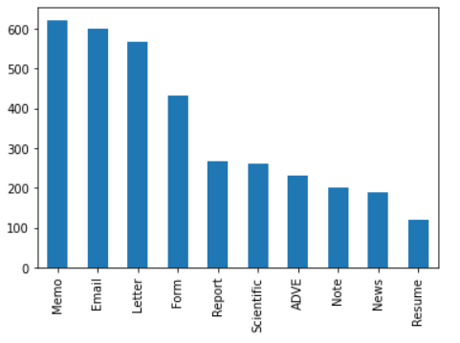
Image Labels and Frequencies
Image Format
Image Type
Unique Labels:
Note, Form, Email, Letter, News
ADVE, Memo, Resume, Scientific, Report
Number of Unique Labels:
10
All 3482
JPEG
images
All 3482
grayscale
images
Counts
Document Category

Slide 11
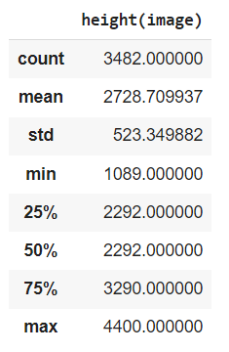
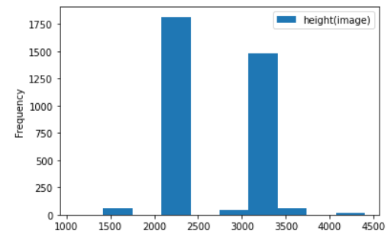
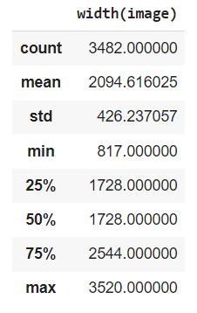
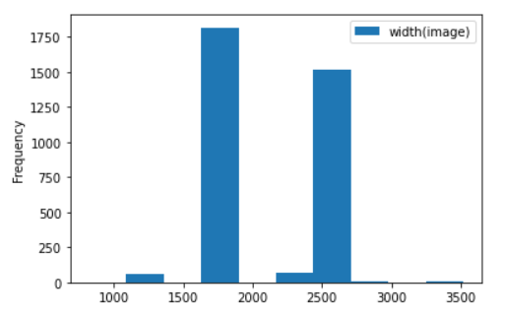
Image Height and Width (For All Images)
325
Unique
Height Dimensions
39
Unique
Width Dimensions

Slide 12
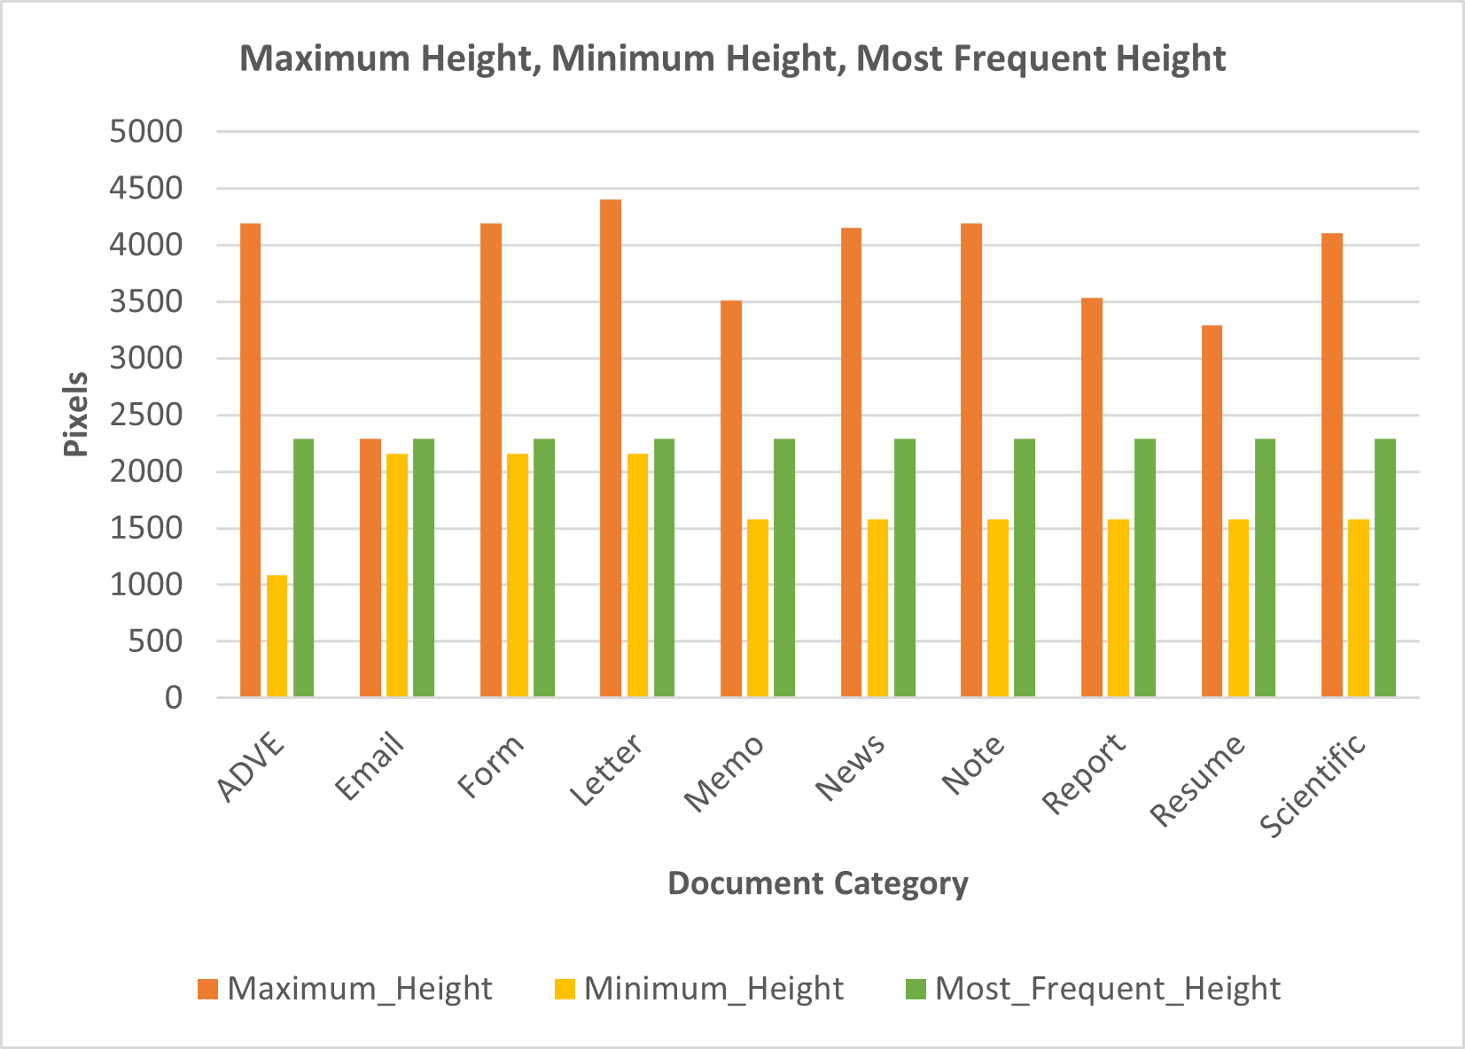
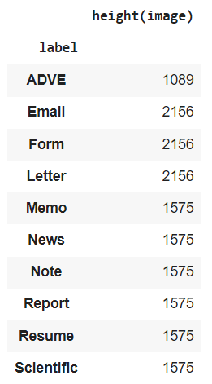
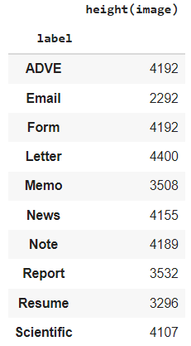
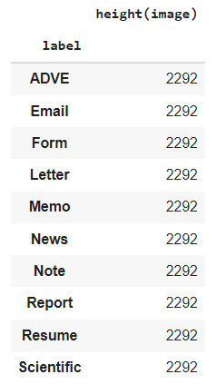
Maximum, Minimum and Most Frequent Height
Minimum
Height
Dimensions
Maximum
Height
Dimensions
Most Frequent
Height
Dimensions

Slide 13
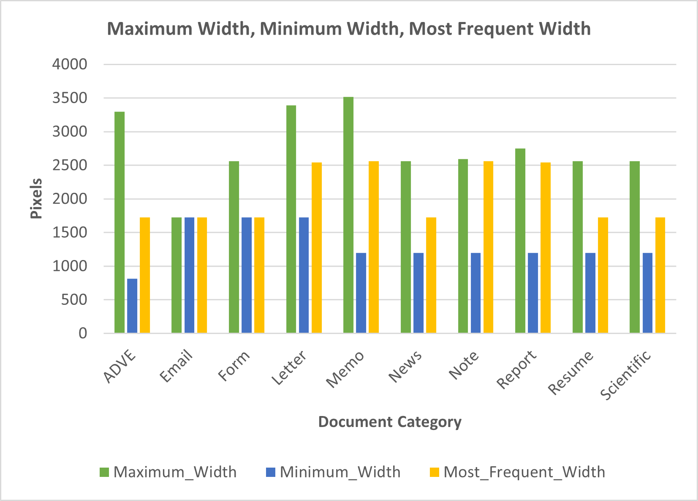
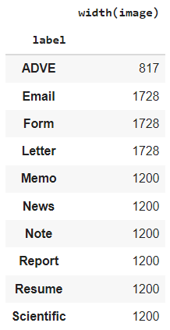
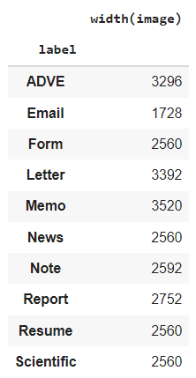
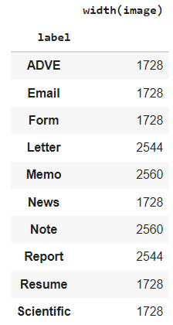
Maximum, Minimum and Most Frequent Width
Minimum
Width
Dimensions
Maximum
Width
Dimensions
Most Frequent
Width
Dimensions

Slide 14
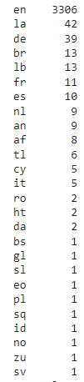
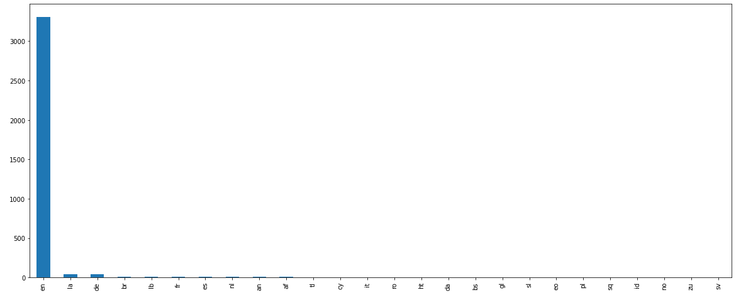
Languages in Images
Images with no text
26
Languages
in Images
21
Images
with no text

Slide 15
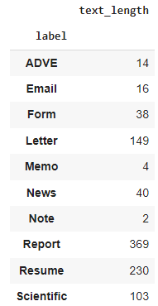
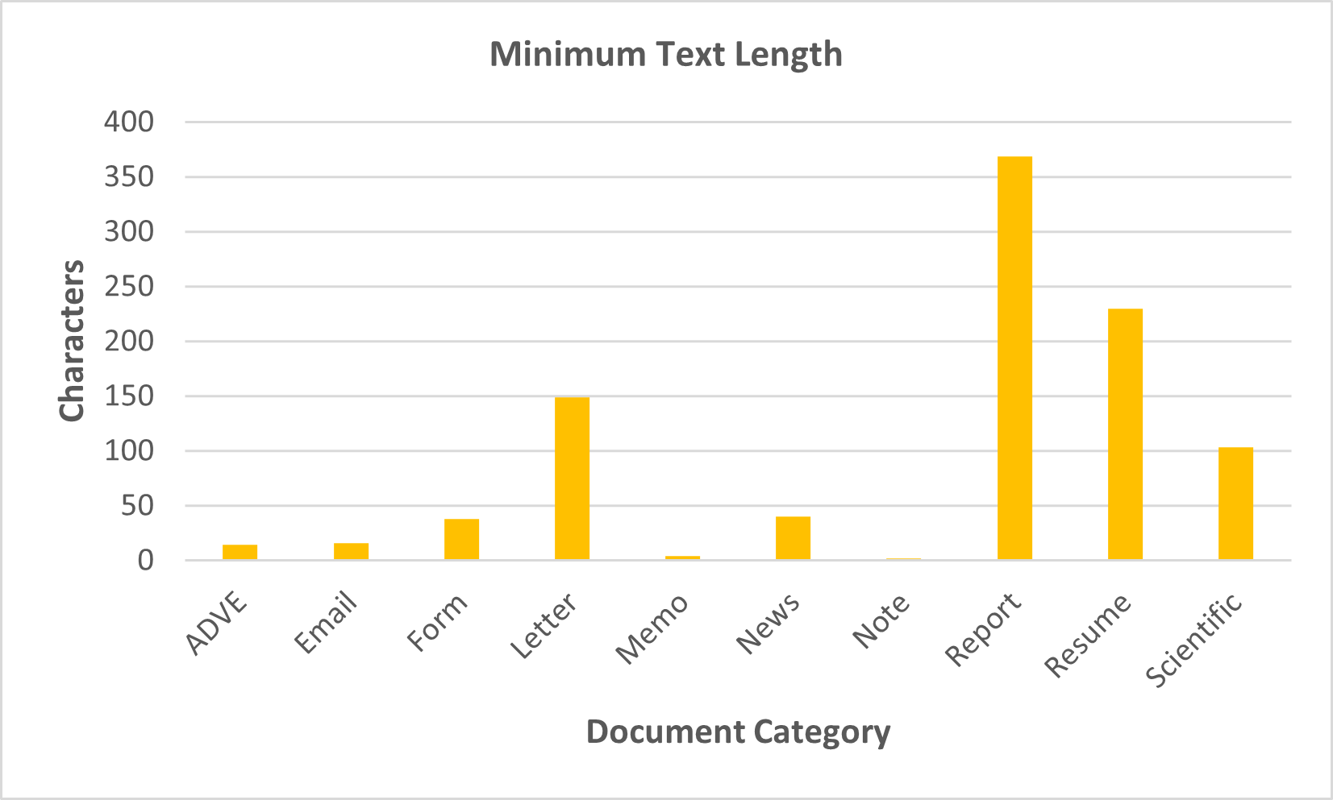
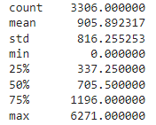
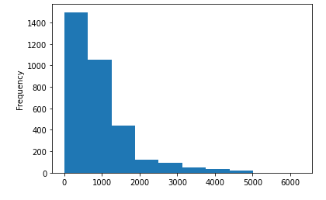
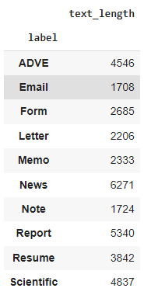
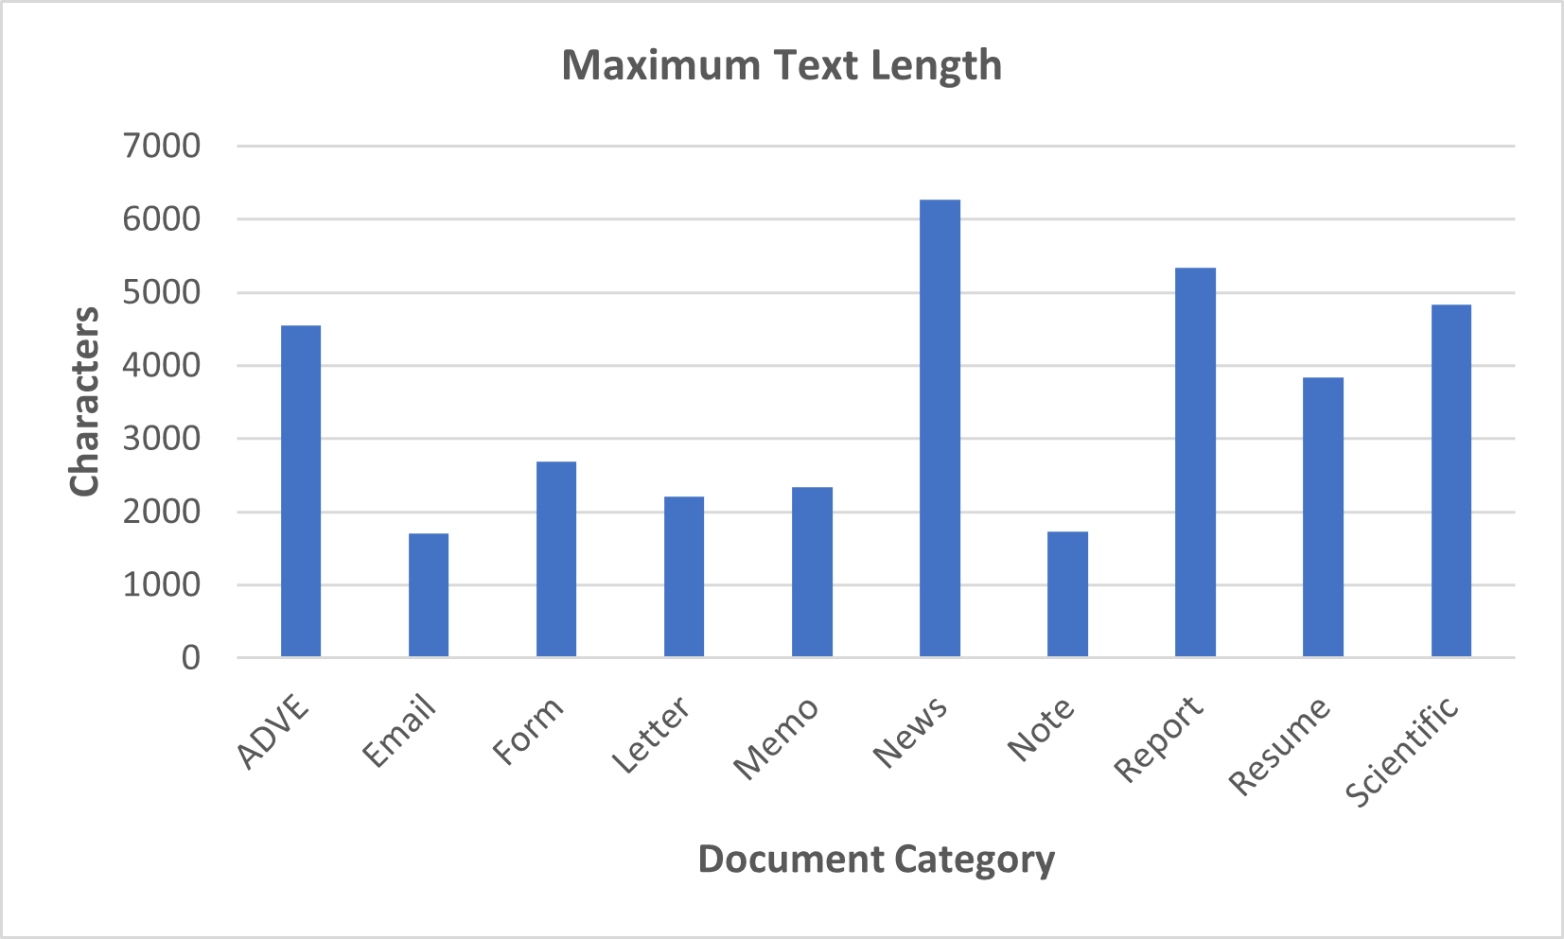
Maximum and Minimum Text Length
Minimum
Text
Length
Text
Length
Frequency
Distribution
Maximum
Text
Length

Slide 16


Word Clouds & Frequency Distribution Plots

Slide 17
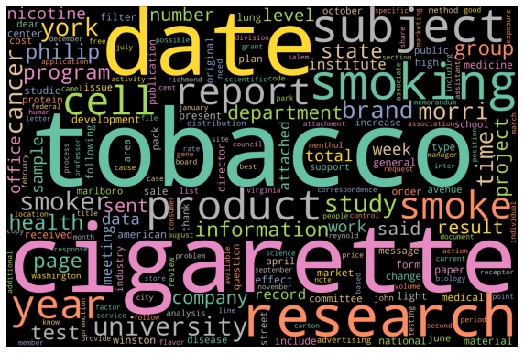
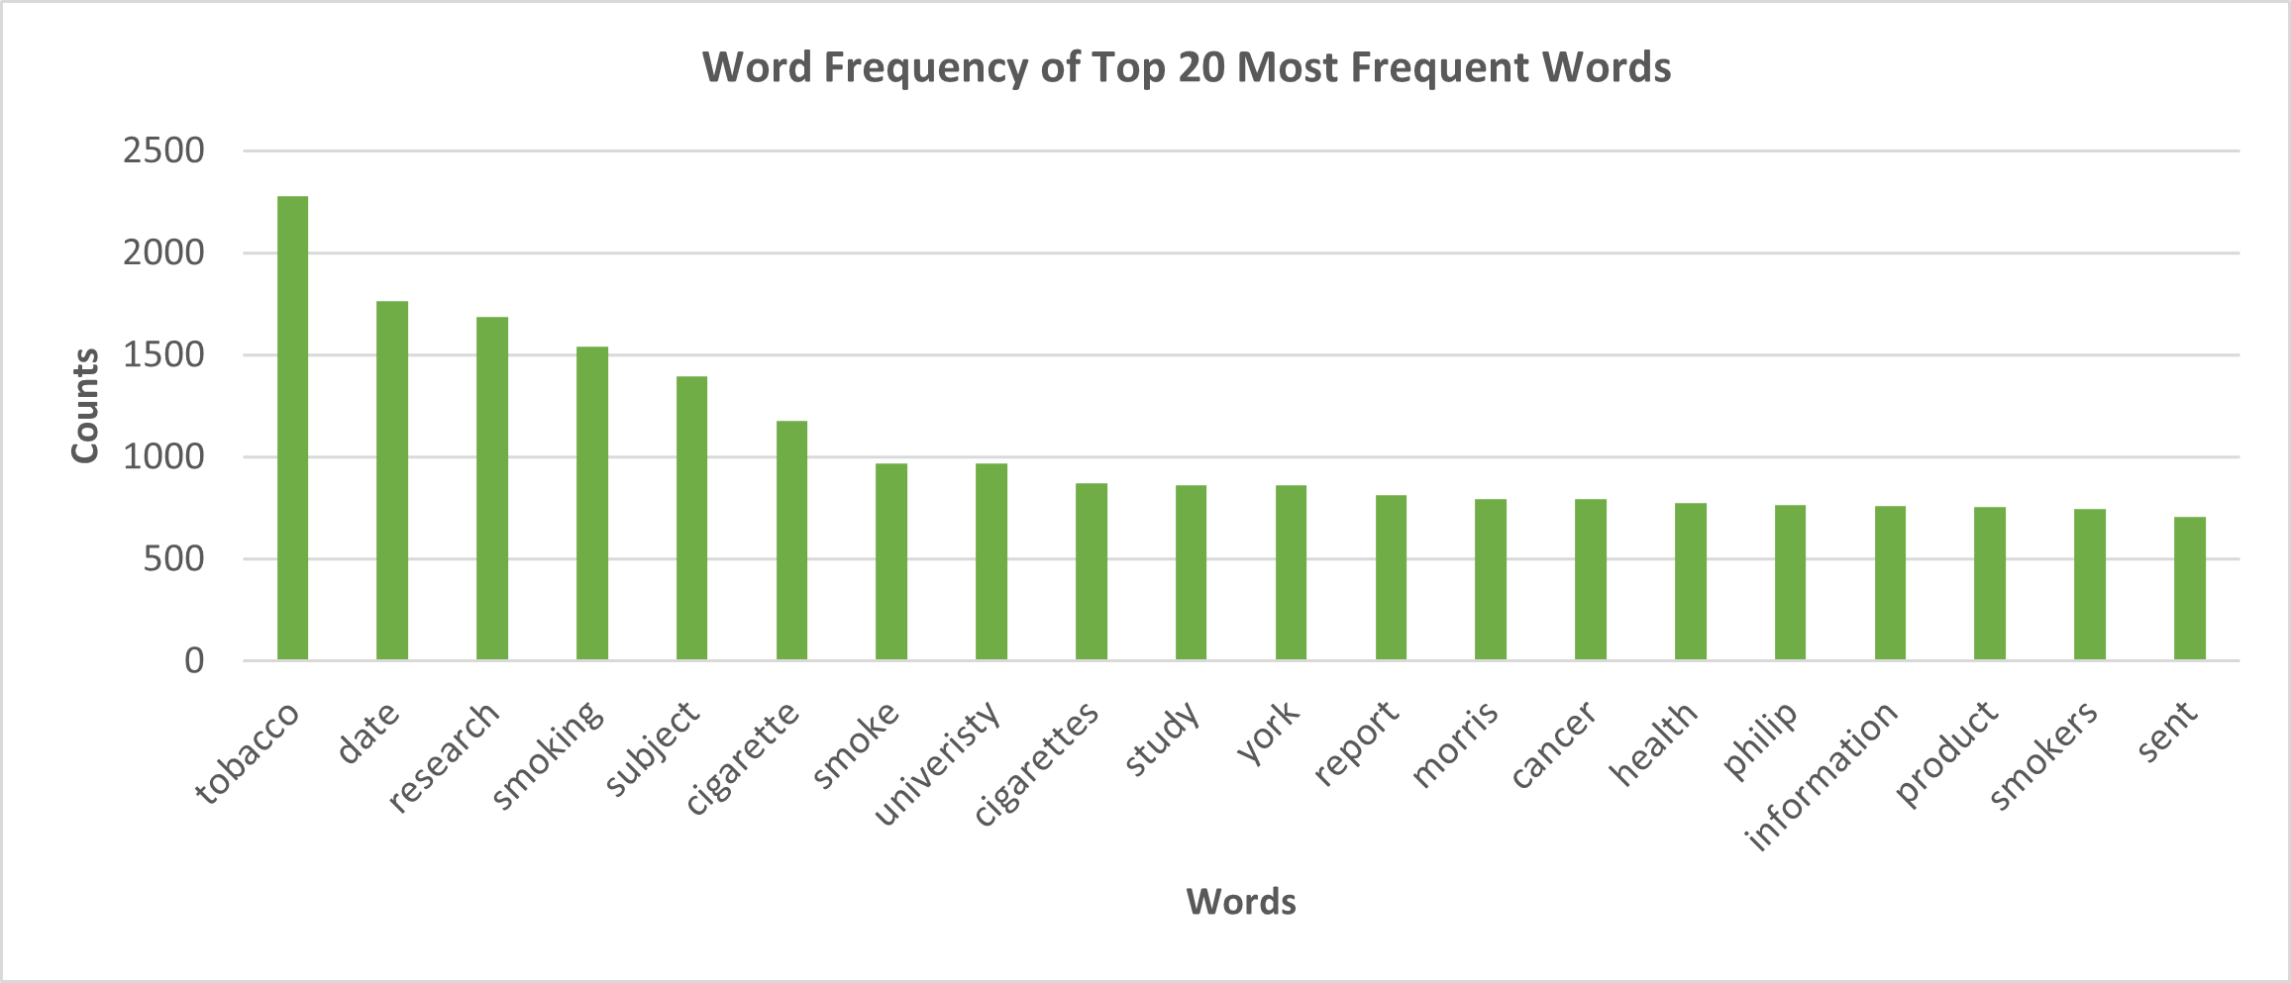
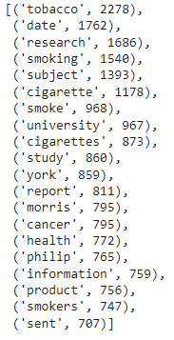
Word Cloud & Top 20 Most Frequent Words for All Images

Slide 18
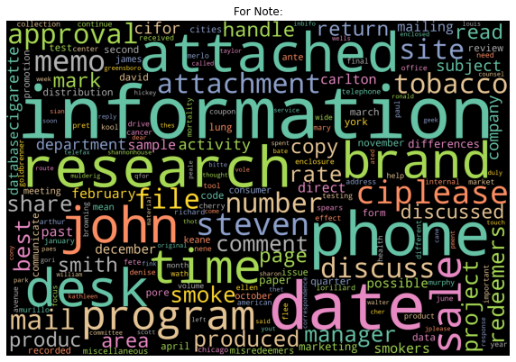
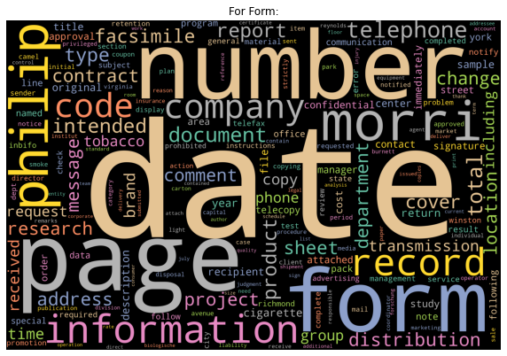
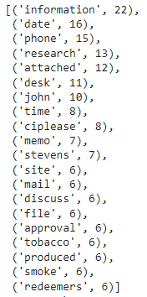
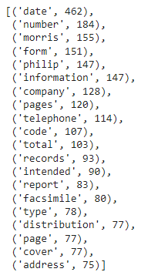
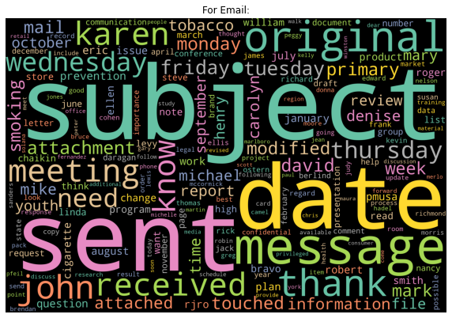
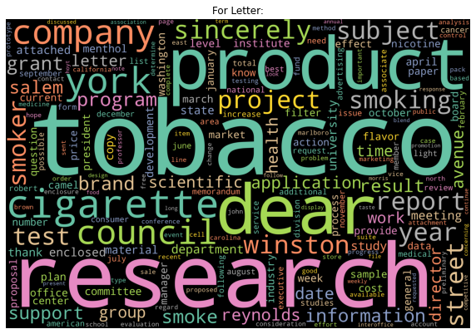
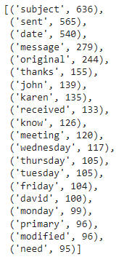
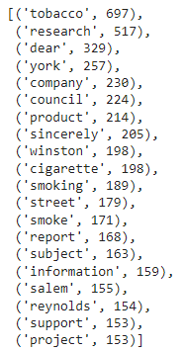
Word Cloud & Top 20 Most Frequent Words for Note, Form, Email and Letter

Slide 19
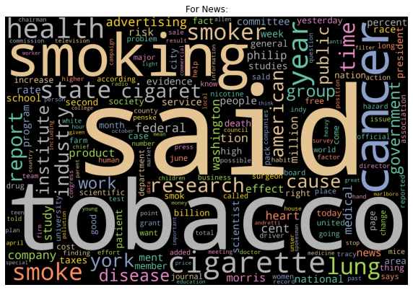
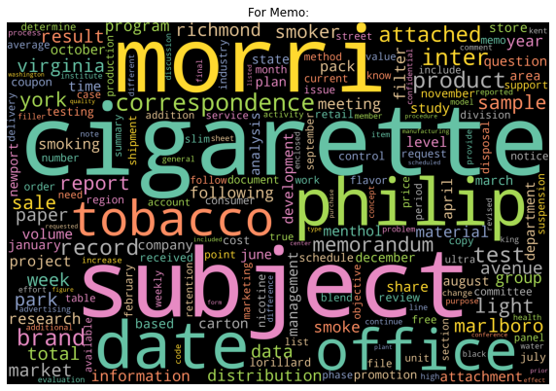
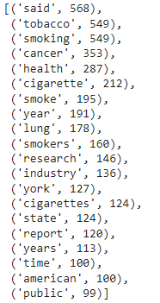
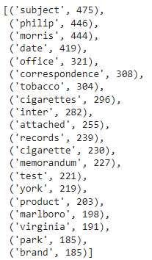
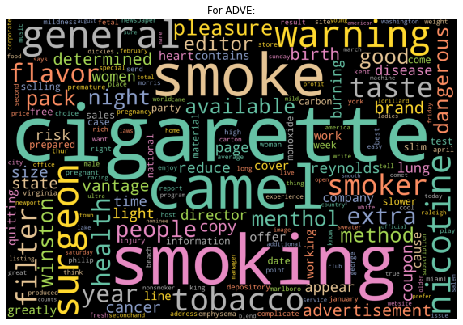
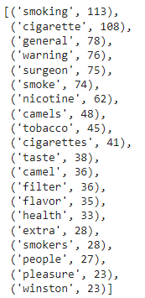
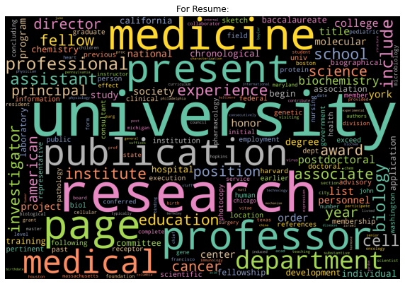
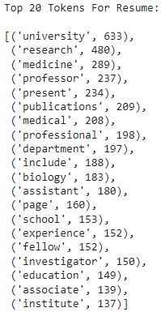
Word Cloud & Top 20 Most Frequent Words for News, ADVE, Memo and Resume

Slide 20
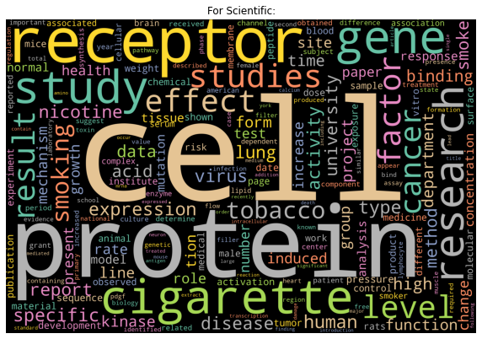
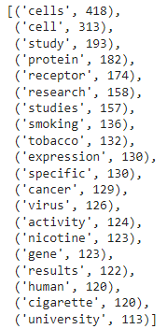
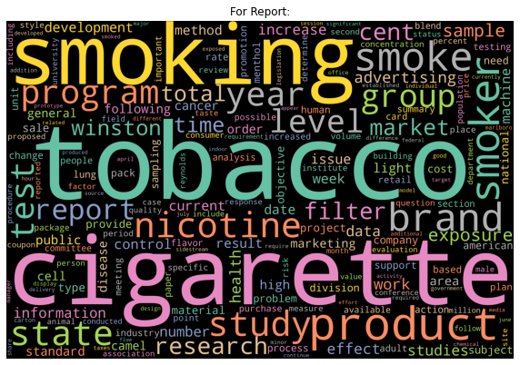
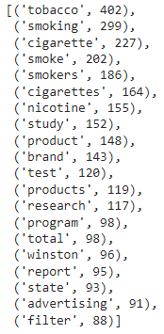
Word Cloud & Top 20 Most Frequent Words for Scientific and Report

Slide 21
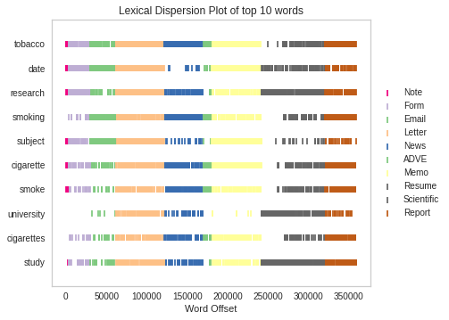
Lexical Dispersion Plot for Top 10 Most Frequent Words
Lexical Dispersion Plot:
Lexical dispersion is a measure of how frequently a word appears across the parts of a corpus.
This plot shows the occurrences of top 10 most frequent words
And
how many words from the beginning of the corpus it appears (word offsets).

Slide 22


Classification Results:
Image Features Only

Slide 23




ResNet50
Trained for 10 epochs
Best accuracy achieved on test dataset :
17.71 %

Slide 24




InceptionV3
Trained for 10 epochs
Best accuracy achieved on test dataset :
17.71 %

Slide 25




EfficientNetB0
Trained for 10 epochs
Best accuracy achieved on test dataset :
16.99 %

Slide 26




EfficientNetB1
Trained for 10 epochs
Best accuracy achieved on test dataset :
6.23 %

Slide 27

Classification Results:
Textual Features Only

Slide 28


Multinomial Naïve Bayes
Random Forest Classifier
TF-IDF vectorization
TF-IDF vectorization
Best accuracy achieved on test dataset :
64.21 %
Best accuracy achieved on test dataset :
83.68 %

Slide 29



BERT (Bidirectional Encoder Representation from Transformers)
Trained for 10 epochs
Best accuracy achieved on test dataset :
69 %

Slide 30
Classification Results:
Image & Textual Features (Both)

Slide 31


Multi-Modal Classification with AutoGluon
Trained 7 different models
Best accuracy achieved on test dataset :
83.31 %
6 models with >80% accuracy
LightGBM, LightedEnsemble_L2, LightGBMXT, CatBoost, XGBoost, LightGBMLarge

Slide 32


Comparison
Trained 4 different models
Trained 3 different models
Trained 7 different models
ResNet50, InceptionV3, EfficientNetB0, EfficientNetB1
Best accuracy achieved on test dataset :
17.71 %
MultinomialNB, RandomForestClassifier, BERT
Best accuracy achieved on test dataset :
83.68 %
LightGBM, WeightedEnsemble_L2, LightGBMXT, CatBoost, XGBoost, LightGBMLarge, NeuralNetTorch
Best accuracy achieved on test dataset :
83.31 %

Slide 33



Conclusion & Future Scope
Conclusion 1
Future Scope 1
Adding text feature with image features boost classification capability
Other ways such as countvectorizer, Bag of Words, etc. can be used for text features
Conclusion 2
Future Scope 2
Opportunities in Future
Text features and image features combined gives consistently better results
Deep Neural Networks and various architectures can be explored
Many other aspects can be researched and explored
Conclusion 3
Future Scope 3
Significant for industries and organizations for managing and sorting their document datasets
GPU processing can be leveraged

Slide 34

References
https://www.altexsoft.com/blog/document-classification/
https://nanonets.com/blog/document-classification/
https://medium.com/@MohammedS/performance-metrics-for-classification-problems-in-machine-learning-part-i-b085d432082b
https://auto.gluon.ai/stable/tutorials/tabular_prediction/tabular-multimodal.html
https://keras.io/examples/vision/image_classification_efficientnet_fine_tuning/
Jayant Kumar, Peng Ye and David Doermann. "Learning Document Structure for Retrieval and Classification." International Conference on Pattern Recognition (ICPR 2012), 2012.
Herbert L. Roitblat, Anne Kershaw, and Patrick Oot. 2010. Document categorization in legal electronic discovery: computer classification vs. manual review. J. Am. Soc. Inf. Sci. Technol. 61, 1 (January 2010), 70–80.
David Martens and Foster Provost. 2014. Explaining data-driven document classifications. MIS Q. 38, 1 (March 2014), 73–100. DOI:https://doi.org/10.25300/MISQ/2014/38.1.04
Nawaz, S., Calefati, A., Caraffini, M., Landro, N., & Gallo, I. (2019). Are These Birds Similar: Learning Branched Networks for Fine-grained Representations. 2019 International Conference on Image and Vision Computing New Zealand (IVCNZ), 1-5.
Icons Credit:
<a target="_blank" href="https://icons8.com/icon/AtzTbgXZOgpf/organization">Organization</a> icon by <a target="_blank" href="https://icons8.com">Icons8</a>
<a target="_blank" href="https://icons8.com/icon/flyjv8osHHkl/business">Business</a> icon by <a target="_blank" href="https://icons8.com">Icons8</a>
<a href="https://www.flaticon.com/free-icons/efficiency" title="efficiency icons">Efficiency icons created by Freepik - Flaticon</a>
<a href="https://www.flaticon.com/free-icons/data-analytics" title="data analytics icons">Data analytics icons created by xnimrodx - Flaticon</a>
<a href="https://www.flaticon.com/free-icons/thought" title="thought icons">Thought icons created by Freepik - Flaticon</a>
<a href="https://www.flaticon.com/free-icons/frequency" title="frequency icons">Frequency icons created by Freepik - Flaticon</a>
<a href="https://www.flaticon.com/free-icons/data-classification" title="data classification icons">Data classification icons created by Chanut-is-Industries - Flaticon</a>
<a href="https://www.flaticon.com/free-icons/photo" title="photo icons">Photo icons created by Pixel perfect - Flaticon</a>
<a href="https://www.flaticon.com/free-icons/text" title="text icons">Text icons created by Pixel perfect - Flaticon</a>
Presentation Template Credit:
Slidesgo : https://slidesgo.com/
Freepik : https://www.freepik.com/

Slide 35

Thank You
Ujjwal – pf10610@umbc.edu

